Slide 1

Factors that affect House Prices
Studying King County U.S.A Prices

Slide 2

Hypothesis
I would expect that the higher the number of bedrooms, the higher the price
The higher the number of bathrooms, the higher the price
The higher the year built, the higher the price
The higher the square-feet of living space, the higher the price
The higher the Condition, the higher the price

Slide 3
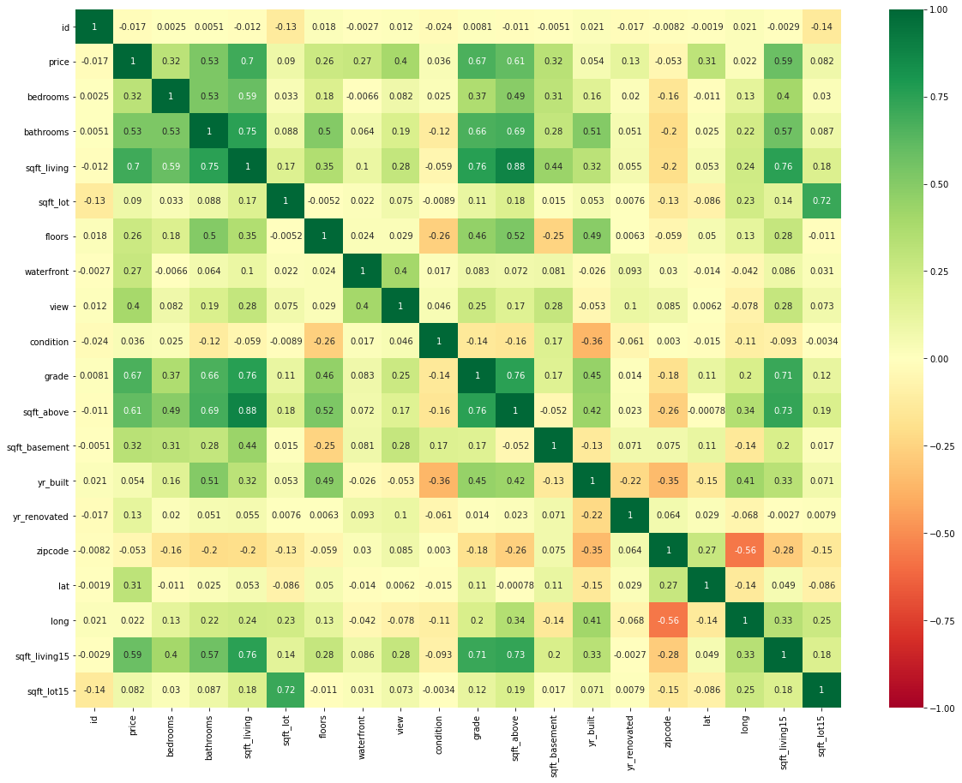
Correlations
Using a python heatmap, we can see that these factors are somewhat correlated with price
Use a linear regression model to try and pinpoint causality
Condition: Surveyors rating from Poor to Very Good
Grade: Represents the construction quality of improvements

Slide 4
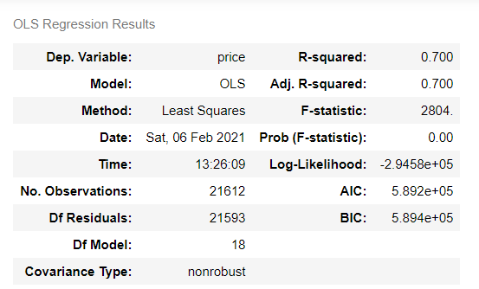
Linear Regression Model Results
70% of the house price can be explained by these variables – overall making it a candidate for multi-linear regression (while individual factors were usually very small (<0.1) R-squared Value)
30% of the house price caused by random/unknown by input data

Slide 5
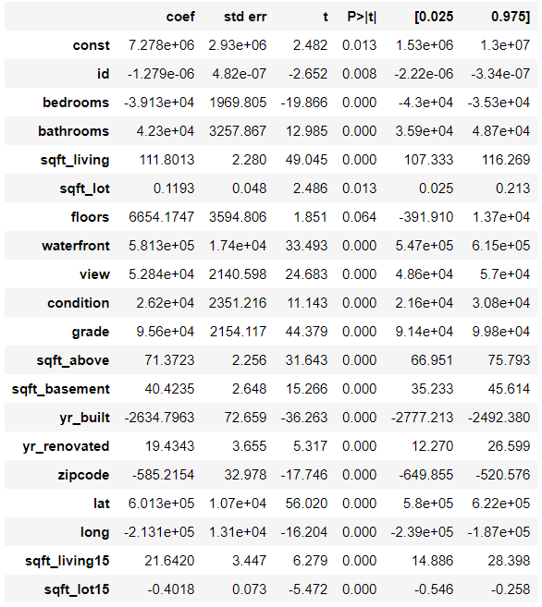
Linear Regression Model Factors
Which values to use
The p-value for each term tests the null hypothesis that the coefficient is equal to zero (no effect)
We can see several P-value’s are above 0.05 suggesting they are statistically insignificant/accept the null-hypothesis
As well as those with low coefficient values
And fields that are not relevant such as ‘id’ and ‘zipcode’

Slide 6
Created Model
Used 6 key factors affecting – the line is the closest to all the points at once
Found they affect the model to varying degrees
The first model had limitations with Bedrooms and the Year built with negative coefficients
So I replaced the model with Condition and View instead

Slide 7
Q&A
Thank you for listening!

Slide 8
Appendix

Slide 9
Agenda
Hypothesis of factors affecting house price
Correlation
Linear Regression Model
Multilinear Regression Model
Polynomial Regression Model

Slide 10
Polynomial Regression

Slide 11
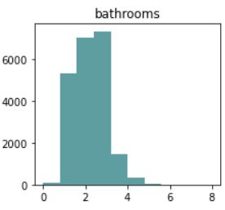
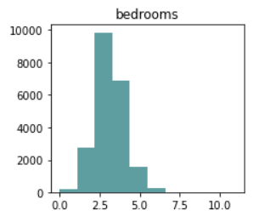
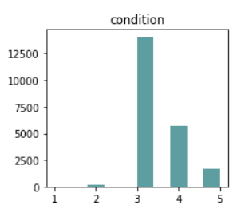
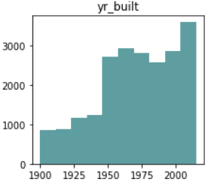
Histograms

Slide 12
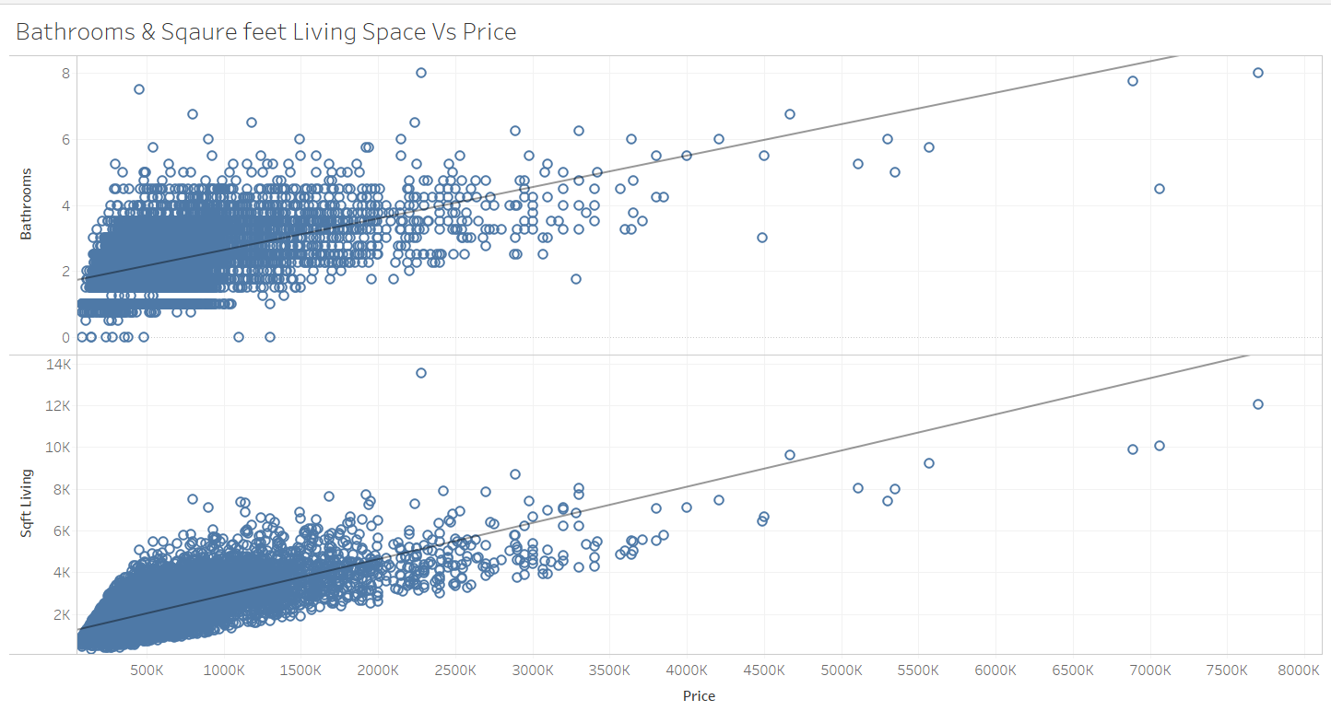
Regression Lines

Slide 13
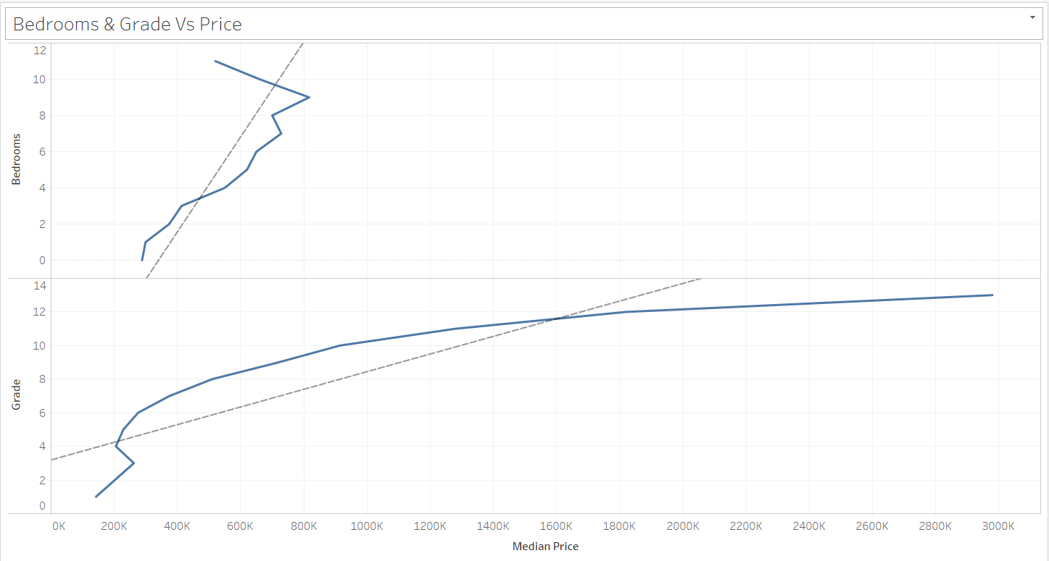
Regression Lines
Bedrooms: We can see that while the trend Vs median price is up, there is a sudden decline around 8 bedrooms

Slide 14
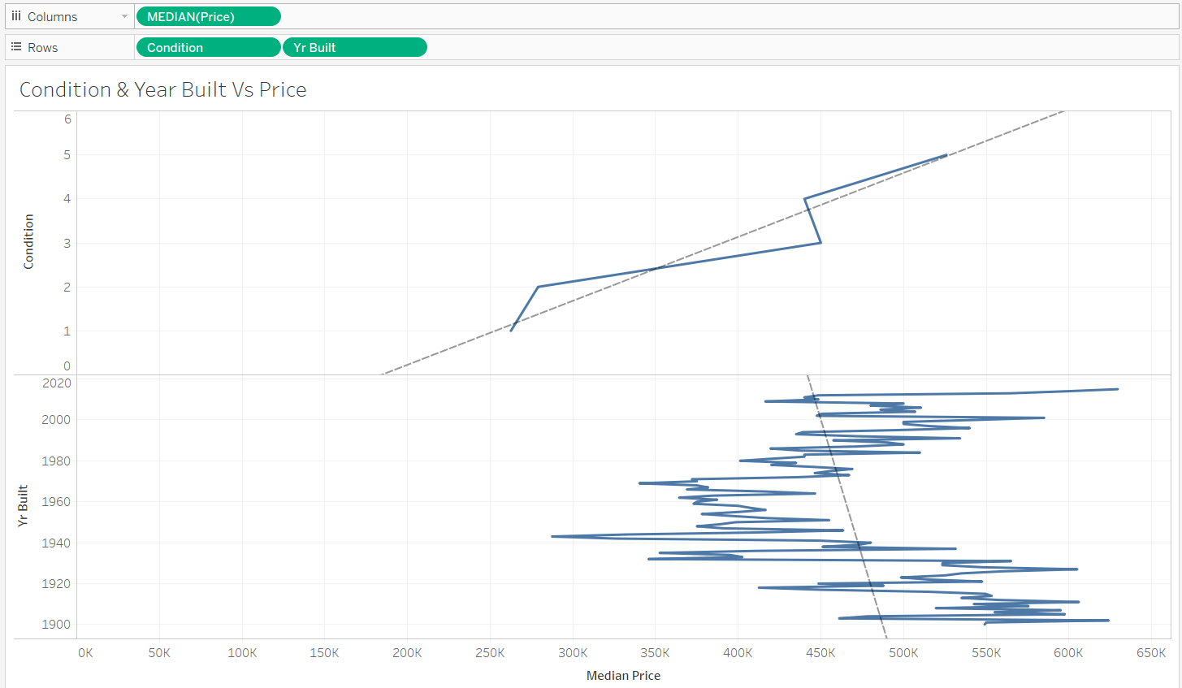
Regression Lines
Year Built: We can see that while the trend Vs median price is decreasing, there is huge volatility

